Slide 1
EC2
Covering all basics of EC2

Slide 2
Virtualization 101
Virtualization is a foundational technology in modern computing that allows multiple virtual environments to operate on a single physical hardware system. By abstracting hardware resources, it enables the creation of virtual machines (VMs), each running its own operating system and applications independently.
Key Concepts:
Virtual Machines (VMs): Software-based emulations of physical computers, providing the same functionality as a physical machine. Each VM runs its own operating system and applications.
Hypervisors: Also known as virtual machine monitors (VMMs), hypervisors are software or hardware platforms that create and manage VMs by allocating physical resources to them. They come in two types:
Type 1 (Bare-Metal) Hypervisors: Run directly on the physical hardware.
Type 2 (Hosted) Hypervisors: Run on a host operating system that provides virtualization services.

Slide 3
Virtualization 101
--- Benefits of Virtualization:
Resource Optimization: Allows multiple VMs to run on a single physical server, maximizing hardware utilization and reducing costs.
Flexibility and Scalability: Enables quick deployment and management of VMs to meet changing business needs.
Isolation: Ensures that each VM operates independently, enhancing security and stability.
Disaster Recovery: Simplifies backup and recovery processes through VM snapshots and migrations.
--- Types of Virtualization:
Server Virtualization: Partitioning a physical server into multiple VMs, each running its own operating system.
Desktop Virtualization: Hosting desktop environments on a central server, allowing remote access from various devices.
Application Virtualization: Running applications in isolated environments separate from the underlying operating system.
Storage Virtualization: Pooling physical storage from multiple devices into a single virtual storage device.
Network Virtualization: Combining hardware and software network resources into a single, software-based administrative entity.

Slide 4
SR IOV
Single Root I/O Virtualization (SR-IOV) is a technology that enables a single physical PCI Express (PCIe) device, such as a network adapter, to present itself as multiple separate virtual devices. This allows multiple virtual machines (VMs) to share direct access to the physical hardware, enhancing performance by reducing the overhead associated with traditional virtualization methods.
Key Components:
Physical Function (PF): A full-featured PCIe function that includes SR-IOV capabilities. It manages and configures the SR-IOV functionality, including the creation of Virtual Functions.
Virtual Functions (VFs): Lightweight PCIe functions derived from the Physical Function. Each VF can be assigned to a VM, allowing direct access to the physical device's resources. The number of VFs available depends on the hardware specifications of the device.

Slide 5
EC2 Architecture
Amazon Elastic Compute Cloud (EC2) is a core component of Amazon Web Services (AWS) that provides scalable computing capacity in the cloud. It enables users to launch virtual servers, known as instances, tailored to their specific needs, facilitating the development and deployment of applications without the constraints of physical hardware.
EC2 Architecture:
Instances: Virtual servers that run applications. Users can choose from various instance types optimized for different use cases, such as compute-intensive or memory-intensive applications.
Amazon Machine Images (AMIs): Pre-configured templates containing the information required to launch an instance, including the operating system and installed software.
Storage Options:
Amazon Elastic Block Store (EBS): Provides persistent block storage volumes for use with EC2 instances.
Instance Store: Offers temporary storage that persists only during the instance's lifetime.
Networking:
Virtual Private Cloud (VPC): Allows users to define a virtual network for their instances, including IP address ranges, subnets, route tables, and network gateways.
Elastic IP Addresses: Static IPv4 addresses designed for dynamic cloud computing, allowing easy remapping to different instances.
Security:
Security Groups: Act as virtual firewalls, controlling inbound and outbound traffic to instances.
Key Pairs: Secure login information for instances, consisting of a public key stored by AWS and a private key held by the user.

Slide 6
EC2 Resilience
AWS designs its infrastructure with resilience in mind, ensuring high availability and fault tolerance for EC2 instances. Key features include:
Availability Zones (AZs): Distinct data centers within a region, engineered to be isolated from failures in other AZs. Deploying instances across multiple AZs enhances fault tolerance.
Elastic Load Balancing (ELB): Distributes incoming application traffic across multiple instances, ensuring no single instance bears too much load and improving fault tolerance.
Auto Scaling: Automatically adjusts the number of running instances based on demand, maintaining application availability and optimizing costs.
Data Backup and Replication:
EBS Snapshots: Enable point-in-time backups of EBS volumes, which can be copied across regions for disaster recovery purposes.
Amazon Machine Images (AMIs): Can be copied across regions to facilitate quick recovery in case of regional failures.
Disaster Recovery Strategies:
Multi-Region Deployments: Deploying applications across multiple regions to ensure continuity in case of a regional outage.
Data Lifecycle Manager: Automates the creation, retention, and deletion of EBS snapshots and AMIs, aiding in data management and recovery.

Slide 7
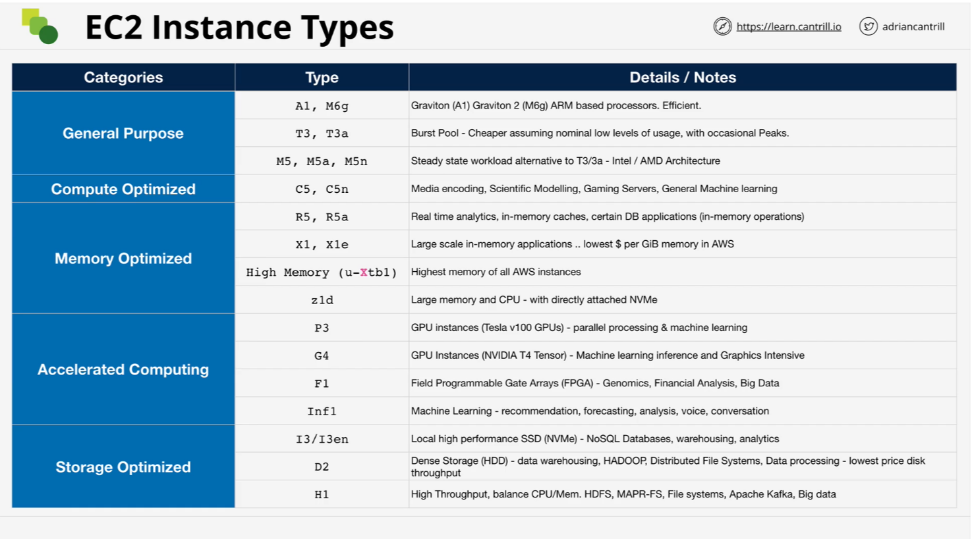
EC2 Instance Type

Slide 8
EC2 Instance Type
Amazon Elastic Compute Cloud (EC2) offers a diverse range of instance types, each tailored to specific use cases and workloads. These instance types vary in their combinations of CPU, memory, storage, and networking capabilities, allowing you to select the most appropriate resources for your applications.
Categories of EC2 Instance Types:
General Purpose Instances:
Use Case: Ideal for applications with balanced CPU, memory, and networking requirements.
Examples:
M6g Instances: Powered by AWS Graviton2 processors, offering a balance of compute, memory, and networking resources.
T4g Instances: Burstable performance instances suitable for a wide range of general-purpose workloads.
Compute Optimized Instances:
Use Case: Designed for compute-intensive applications that benefit from high-performance processors.
Examples:
C7g Instances: Powered by AWS Graviton3 processors, providing high compute performance for workloads such as high-performance computing (HPC) and batch processing.
C6i Instances: Featuring 3rd generation Intel Xeon Scalable processors, ideal for compute-bound applications.

Slide 9
EC2 Instance Type
Memory Optimized Instances:
Use Case: Suited for memory-intensive applications requiring high memory capacity.
Examples:
R7g Instances: Powered by AWS Graviton3 processors, optimized for memory-intensive workloads like real-time big data analytics and in-memory caching.
X2idn Instances: Offering high memory and compute performance, suitable for large-scale in-memory databases.
Storage Optimized Instances:
Use Case: Optimized for applications requiring high, sequential read and write access to large datasets on local storage.
Examples:
I4i Instances: Designed for I/O-intensive workloads, featuring high-performance NVMe storage.
D3 Instances: Ideal for distributed file systems and data-intensive applications, offering high disk throughput.
Accelerated Computing Instances:
Use Case: Intended for applications that benefit from hardware accelerators, such as GPUs or FPGAs.
Examples:
P4 Instances: Equipped with NVIDIA GPUs, suitable for machine learning training and high-performance computing.
Inf1 Instances: Powered by AWS Inferentia chips, optimized for machine learning inference workloads.

Slide 10
Storage
Amazon Elastic Compute Cloud (EC2) offers a variety of storage options to cater to different application needs.
1. Amazon Elastic Block Store (EBS):
EBS provides persistent block-level storage volumes that can be attached to EC2 instances. These volumes function like traditional hard drives, allowing for data persistence beyond the lifecycle of an instance. EBS is suitable for applications requiring a file system, databases, or raw block storage. It offers various volume types to balance performance and cost:
General Purpose SSD (gp2/gp3): Ideal for a broad range of workloads, including system boot volumes, virtual desktops, and development environments.
Provisioned IOPS SSD (io1/io2): Designed for latency-sensitive transactional workloads that require high IOPS, such as databases.
Throughput Optimized HDD (st1): Best for frequently accessed, throughput-intensive workloads like big data and data warehouses.
Cold HDD (sc1): Suitable for less frequently accessed data, providing a low-cost option for infrequent workloads.
2. Instance Store:
Instance store provides temporary block-level storage directly attached to the host machine. This storage offers high I/O performance but is ephemeral; data is lost when the instance is stopped or terminated. Instance store is ideal for temporary storage of information that changes frequently, such as buffers, caches, scratch data, or other temporary content.

Slide 11
Storage
3. Amazon Elastic File System (EFS):
EFS is a scalable, fully managed elastic NFS file system for use with AWS Cloud services and on-premises resources. It is designed to grow and shrink automatically as you add and remove files, providing a simple interface with standard file system semantics. EFS is suitable for a broad spectrum of use cases, including web serving and content management, enterprise applications, media processing workflows, and big data analytics.
4. Amazon Simple Storage Service (S3):
S3 is an object storage service that offers industry-leading scalability, data availability, security, and performance. It is designed for storing and retrieving any amount of data from anywhere on the internet. S3 is ideal for backup and restore, archival storage, big data analytics, and as a data lake for analytics.

Slide 12
Elastic Block Store (EBS)
Amazon Elastic Block Store (EBS) is a high-performance block storage service designed for use with Amazon Elastic Compute Cloud (EC2) instances. It provides persistent storage that remains available independently of the EC2 instance lifecycle, making it suitable for a wide range of applications, including databases, file systems, and enterprise applications.
EBS Architecture Overview:
Volumes: EBS volumes are virtualized storage units that can be attached to EC2 instances. They function similarly to physical hard drives but offer the flexibility and scalability of cloud infrastructure. Volumes can be dynamically resized, and their performance characteristics can be adjusted to meet specific workload requirements.
Snapshots: EBS supports point-in-time snapshots, which are incremental backups of volumes stored in Amazon S3. Snapshots facilitate data protection, disaster recovery, and the creation of new volumes with identical data. They can also be copied across AWS regions to enhance data durability and availability.

Slide 13
Elastic Block Store (EBS)
Performance Optimization: EBS offers various volume types optimized for different performance needs:
General Purpose SSD (gp2/gp3): Balanced performance for a wide range of workloads.
Provisioned IOPS SSD (io1/io2): High-performance volumes designed for latency-sensitive transactional workloads.
Throughput Optimized HDD (st1) and Cold HDD (sc1): Cost-effective options for large, sequential workloads.
Data Encryption: EBS provides seamless encryption of data at rest and in transit, utilizing AWS Key Management Service (KMS) to manage encryption keys. This ensures data security and compliance with regulatory requirements.
Availability and Durability: EBS volumes are designed for high availability and durability, replicating data within the same Availability Zone to protect against hardware failures. This replication ensures that data remains accessible and resilient to component failures.
Elastic Volumes: EBS allows for dynamic modification of volume size, performance characteristics, and volume type without downtime, enabling seamless scaling as application requirements evolve.

Slide 14
EBS Volume Type - General Purpose
Amazon Elastic Block Store (EBS) offers General Purpose SSD volumes, specifically the gp2 and gp3 types, designed to balance price and performance for a wide range of workloads.
General Purpose SSD (gp2):
Performance Characteristics:
Baseline Performance: Provides a baseline performance of 3 IOPS per GiB.
Burst Capability: Can burst up to 3,000 IOPS for extended periods, depending on volume size.
Maximum IOPS: Up to 16,000 IOPS for volumes larger than 5,334 GiB.
Throughput: Maximum throughput of 250 MiB/s.
Use Cases: Ideal for boot volumes, low-latency interactive applications, and development and test environments.
General Purpose SSD (gp3):
Performance Characteristics:
Baseline Performance: Delivers a consistent baseline of 3,000 IOPS and 125 MiB/s throughput, regardless of volume size.
Scalability: Allows independent scaling of IOPS up to 16,000 and throughput up to 1,000 MiB/s, based on application requirements.
Use Cases: Suitable for a broad range of applications, including virtual desktops, medium-sized databases, and latency-sensitive workloads.

Slide 15
EBS Volume Type - General Purpose
--- Key Differences Between gp2 and gp3:
Performance Scaling: gp2 performance is tied to volume size, offering higher IOPS with larger volumes, whereas gp3 provides predictable performance irrespective of volume size.
Cost Efficiency: gp3 volumes are generally more cost-effective, offering lower pricing with the flexibility to provision performance independently, potentially leading to cost savings.
Customization: gp3 allows for the customization of IOPS and throughput independently of volume size, enabling precise tuning to meet specific workload demands.

Slide 16
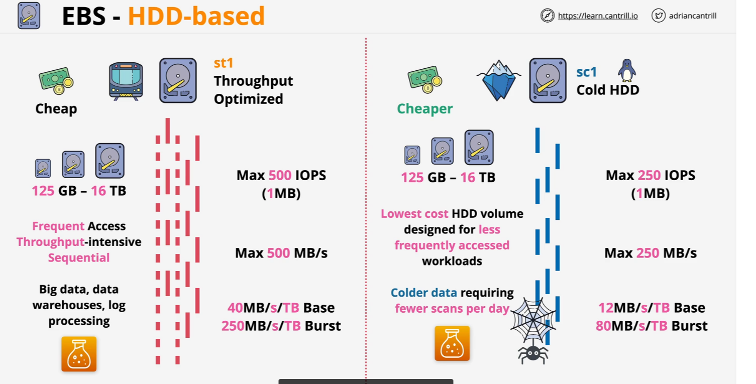
EBS Volume Types - HDD-Based

Slide 17
Provisioned IOPS
Amazon Elastic Block Store (EBS) offers Provisioned IOPS SSD (io1 and io2) volumes, designed to deliver high-performance storage for critical, IOPS-intensive, and throughput-intensive workloads that require low latency.
Provisioned IOPS SSD (io1 and io2) Volumes:
Performance Characteristics:
Consistent Performance: Designed to deliver the provisioned IOPS performance 99.9% of the time.
High IOPS: Capable of delivering up to 64,000 IOPS per volume.
High Throughput: Designed to achieve up to 1,000 MiB/s of throughput per volume.
Use Cases:
Ideal for I/O-intensive workloads, particularly database workloads that are sensitive to storage performance and consistency in random access I/O throughput.
Durability:
Designed to provide 99.8% - 99.9% durability with an annual failure rate (AFR) of 0.2% - 0.1%, where failure refers to a complete or partial loss of the volume.
Volume Size:
Supports volumes ranging from 4 GiB to 16 TiB.
Cost Consideration:
Pricing includes charges for both storage capacity and the provisioned IOPS rate.

Slide 18
Instant Store Volume
An instance store volume provides temporary block-level storage for your Amazon EC2 instance. This storage is physically attached to the host computer and is ideal for temporary data that changes frequently, such as buffers, caches, scratch data, and other ephemeral content.
--- Key Characteristics of Instance Store Volumes:
Ephemeral Nature: Data stored in instance store volumes persists only during the lifetime of the associated EC2 instance. If the instance is stopped, terminated, or fails, the data is lost. However, data remains intact during instance reboots.
High I/O Performance: Instance store volumes can offer high random I/O performance with low latency, making them suitable for workloads that require temporary high-speed storage.
No Additional Cost: There is no extra charge to use the instance store volumes provided with your instance; they are included as part of the instance's usage cost.

Slide 19
Instant Store Volume
Limitations:
Data Volatility: Due to their ephemeral nature, instance store volumes are not suitable for data that needs to persist beyond the instance's lifecycle. It's recommended to avoid storing valuable or critical data on instance store volumes.
Limited Availability: Not all EC2 instance types support instance store volumes. The number, size, and type of instance store volumes vary by instance type and size. For example, some newer instance types like M6, C6, and R6 do not support instance store volumes, while others like M5d, C6gd, and R6gd do.
Use Cases:
Temporary Storage: Ideal for temporary files, caches, and data that can be easily recreated.
High-Performance Scratch Space: Suitable for applications requiring high-speed temporary storage, such as processing intermediate data.

Slide 20
Choosing between the Instance Store and EBS
When deciding between EC2 Instance Store and Amazon Elastic Block Store (EBS) for your storage needs, it's essential to understand their distinct characteristics to make an informed choice.
--- EC2 Instance Store:
Ephemeral Storage: Data persists only during the instance's lifetime. Stopping, hibernating, or terminating the instance results in data loss. However, data remains intact during instance reboots.
High I/O Performance: Offers high random I/O performance with low latency, suitable for temporary storage like caches, buffers, and scratch data.
No Additional Cost: Included in the instance's usage cost without extra charges.
Limited Availability: Not all instance types support instance store volumes, and configurations vary by instance type and size.
--- Amazon EBS:
Persistent Storage: Data remains intact independently of the instance's state, ensuring durability across instance stops, terminations, and reboots.
Flexible Attachment: EBS volumes can be detached and reattached to different instances within the same availability zone.
Scalability: Supports volumes up to 16 TiB, accommodating a wide range of storage requirements.
Backup and Snapshots: Allows creation of snapshots for data backup and recovery, enhancing data protection strategies.

Slide 21
Choosing between the EC2 Instance Store and EBS
Choosing Between Instance Store and EBS:
Use Cases for Instance Store:
Temporary data storage that can be regenerated.
High-performance scratch space for applications requiring low-latency access.
Use Cases for EBS:
Applications requiring persistent storage with data durability.
Workloads necessitating data backup, recovery, and encryption.
Scenarios where storage needs to be resized or moved between instances.

Slide 22
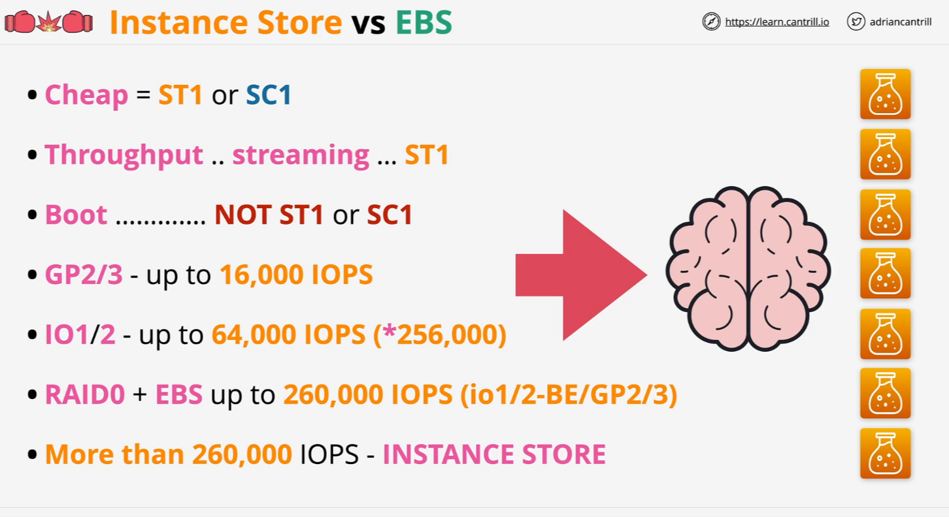
Instance Store vs EBS

Slide 23
EBS Volume Demo
This is the link of commands webpage which we use to play with EBS Volume.
https://learn-cantrill-labs.s3.amazonaws.com/awscoursedemos/0004-aws-associate-ec2-ebs-demo/lesson_commands_AL2023.txt

Slide 24
Snapshots, Restore & Fast Snapshot Restore
Amazon Elastic Block Store (EBS) provides robust features for data backup, restoration, and rapid volume initialization, ensuring data durability and operational efficiency.
Snapshots:
Definition: EBS snapshots are point-in-time backups of your EBS volumes, stored in Amazon S3. They capture the state of a volume at a specific moment, allowing for data protection and recovery.
Usage: Snapshots are incremental, meaning only the blocks that have changed since the last snapshot are saved, optimizing storage costs and reducing time. They can be used to create new EBS volumes, facilitating data restoration or replication across different regions and accounts.
Restore:
Process: To restore data, you can create a new EBS volume from a snapshot. This volume can then be attached to an EC2 instance, making the data accessible.
Initialization: When a volume is created from a snapshot, it undergoes initialization (lazy loading). The first time a block is accessed, there may be a slight delay as the block is fetched from Amazon S3.
Fast Snapshot Restore (FSR):
Purpose: FSR enables you to create EBS volumes from snapshots that are fully initialized upon creation, eliminating the latency of first-time block access. This ensures that volumes deliver their full performance immediately.

Slide 25
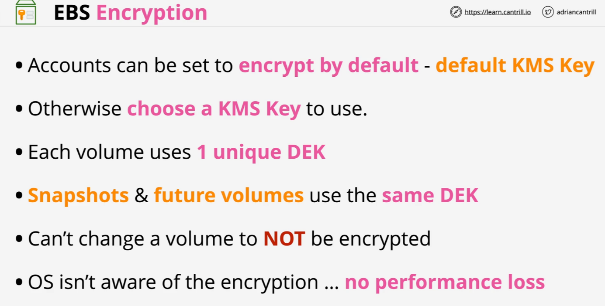
EBS Encryption

Slide 26
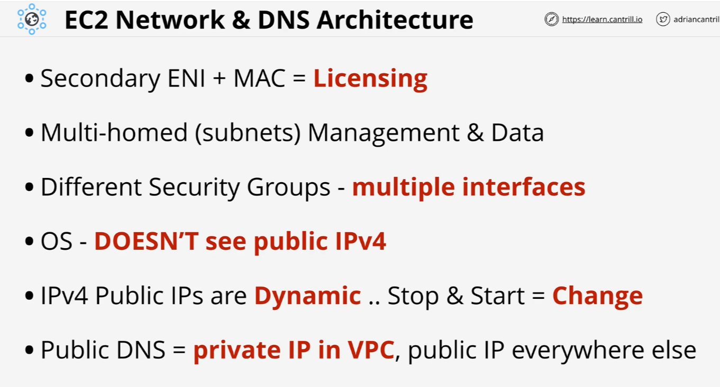
Network Interfaces, Instance IPs and DNS

Slide 27
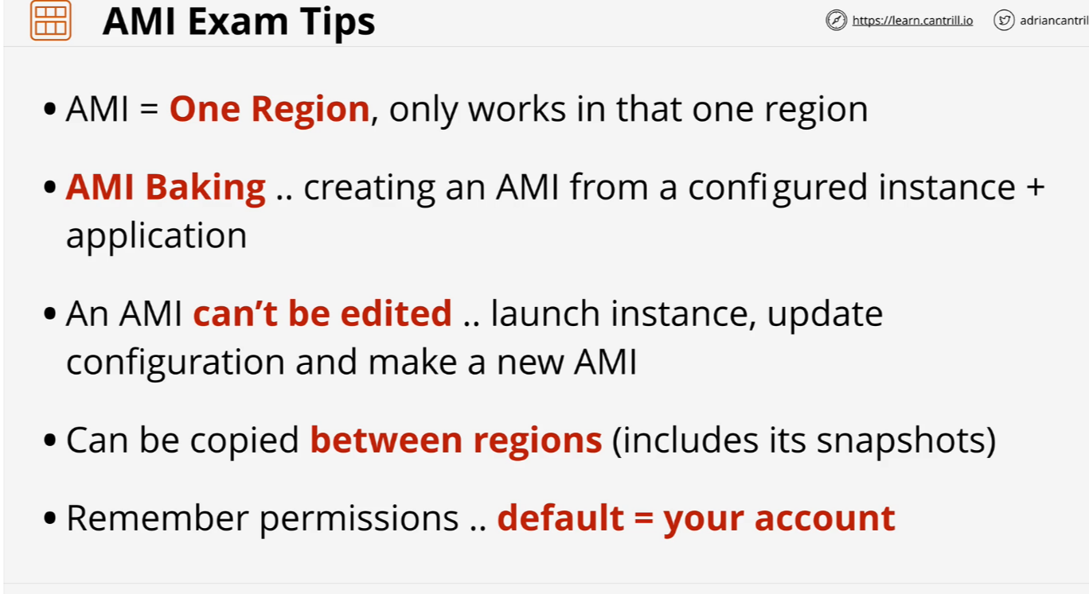
Amazon Machine Images (AMI)

Slide 28
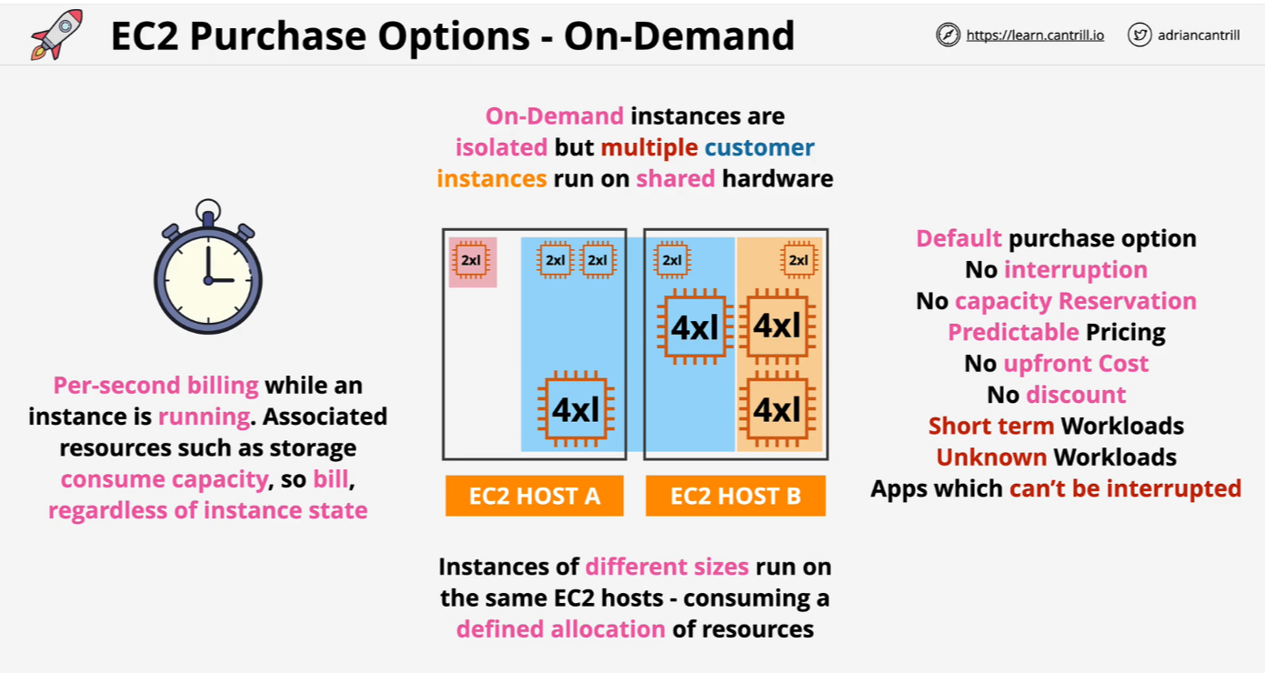
EC2 Purchase Options – On Demand

Slide 29
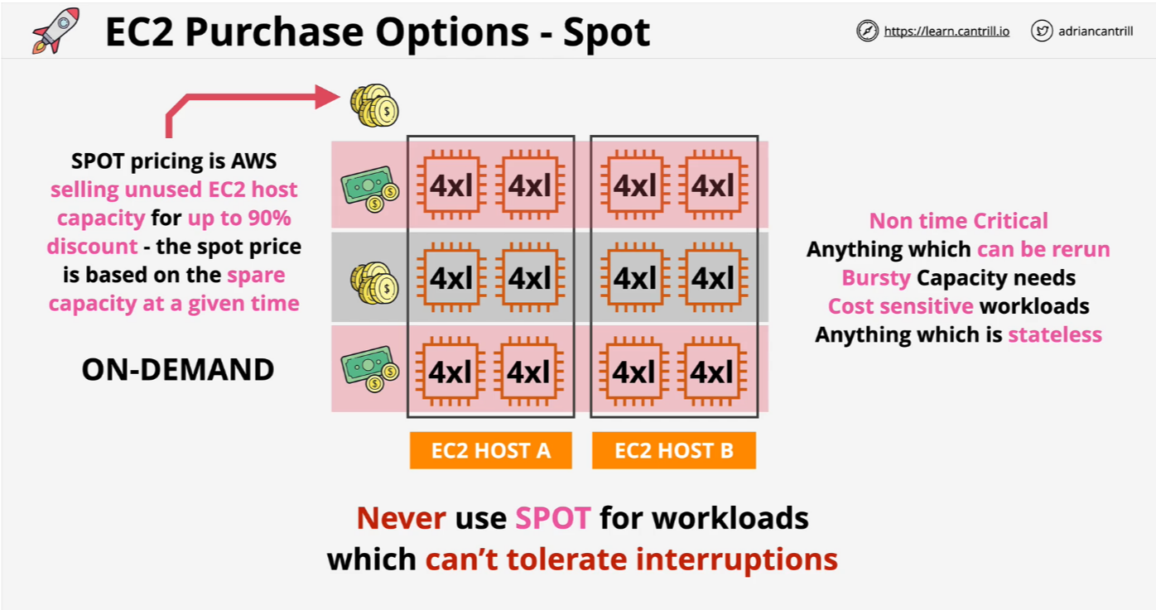
EC2 Purchase Options - Spot

Slide 30
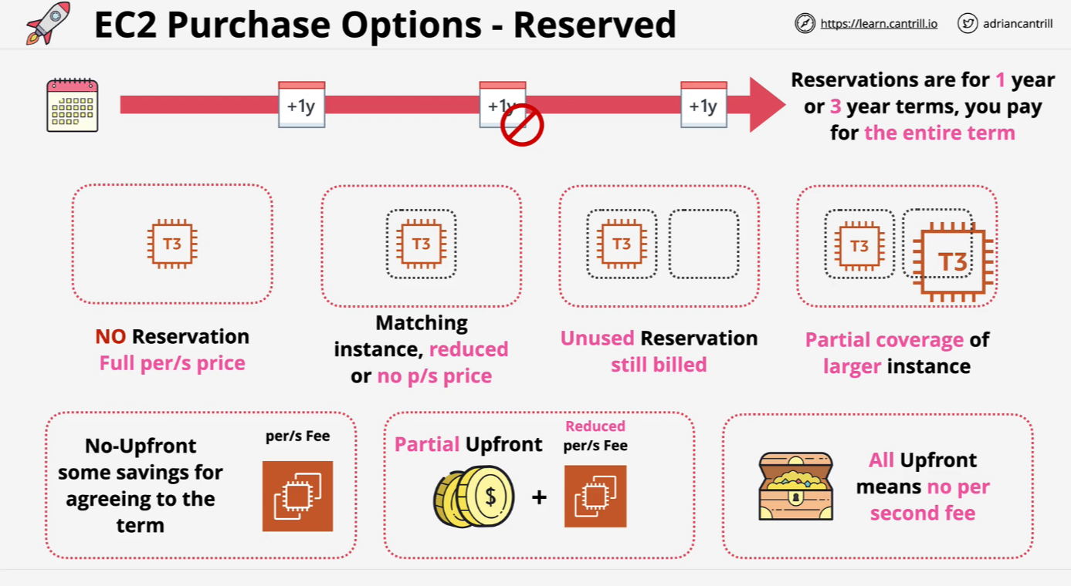
EC2 Purchase Options – Reserved

Slide 31
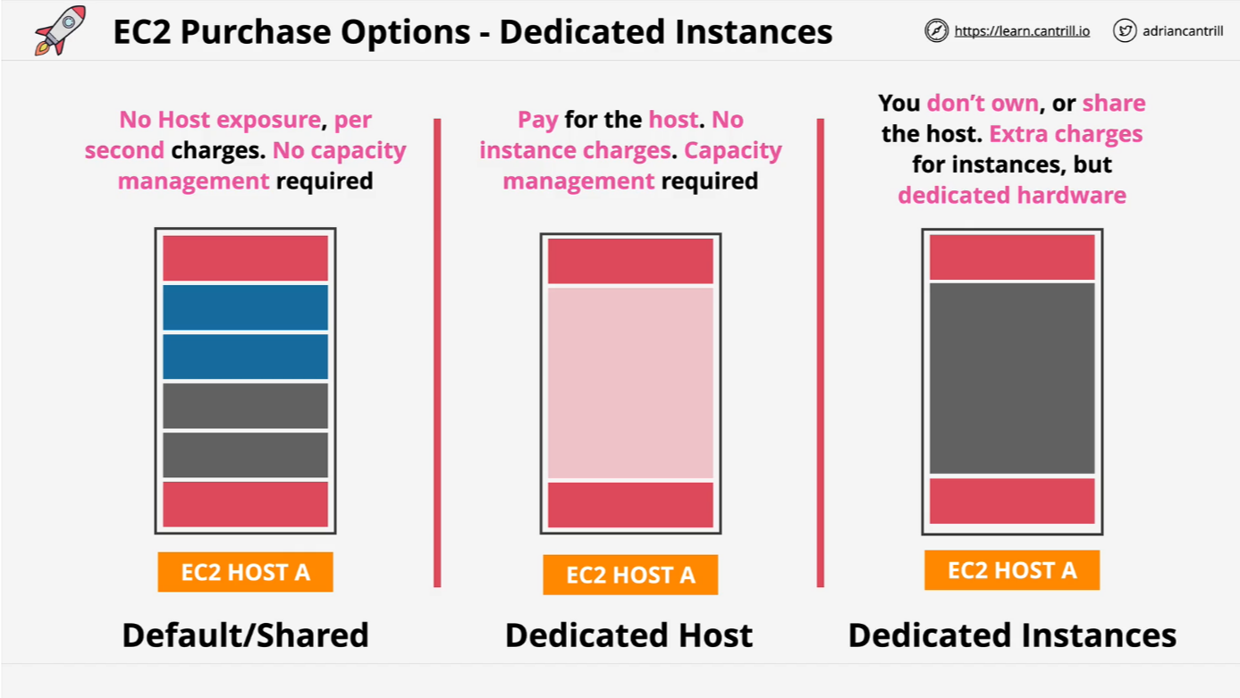
EC2 Purchase Options – Dedicated Instances

Slide 32
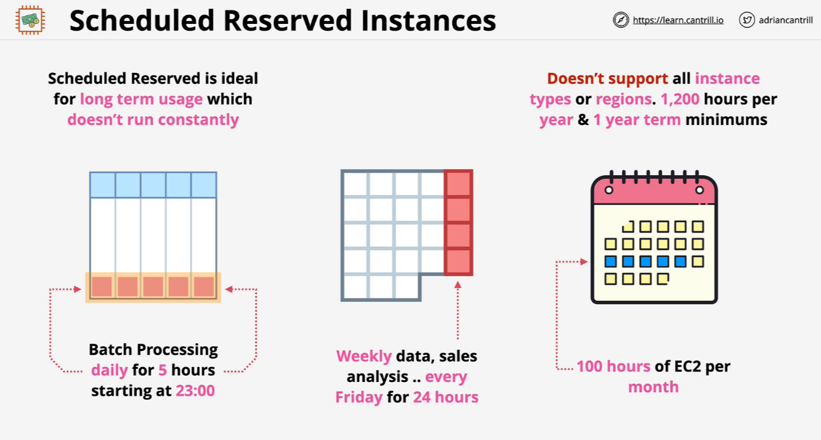
Scheduled Reserved Instances

Slide 33
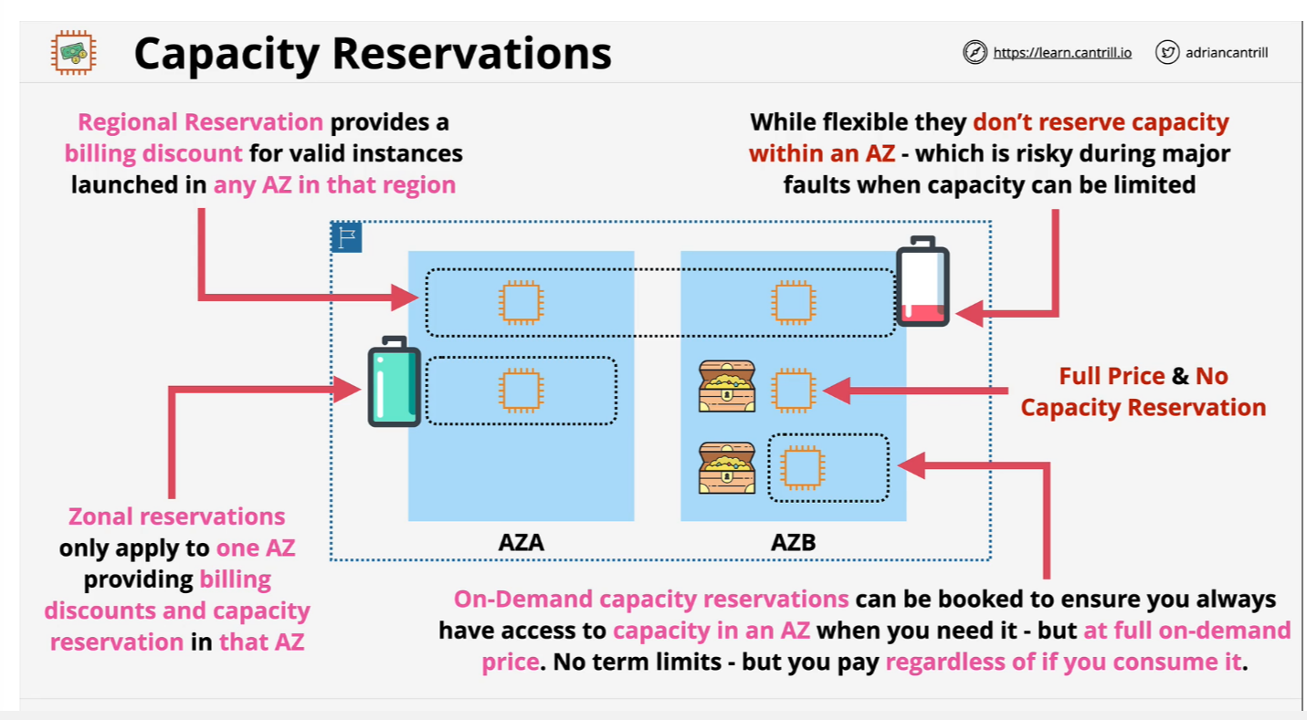
Capacity Reservation

Slide 34
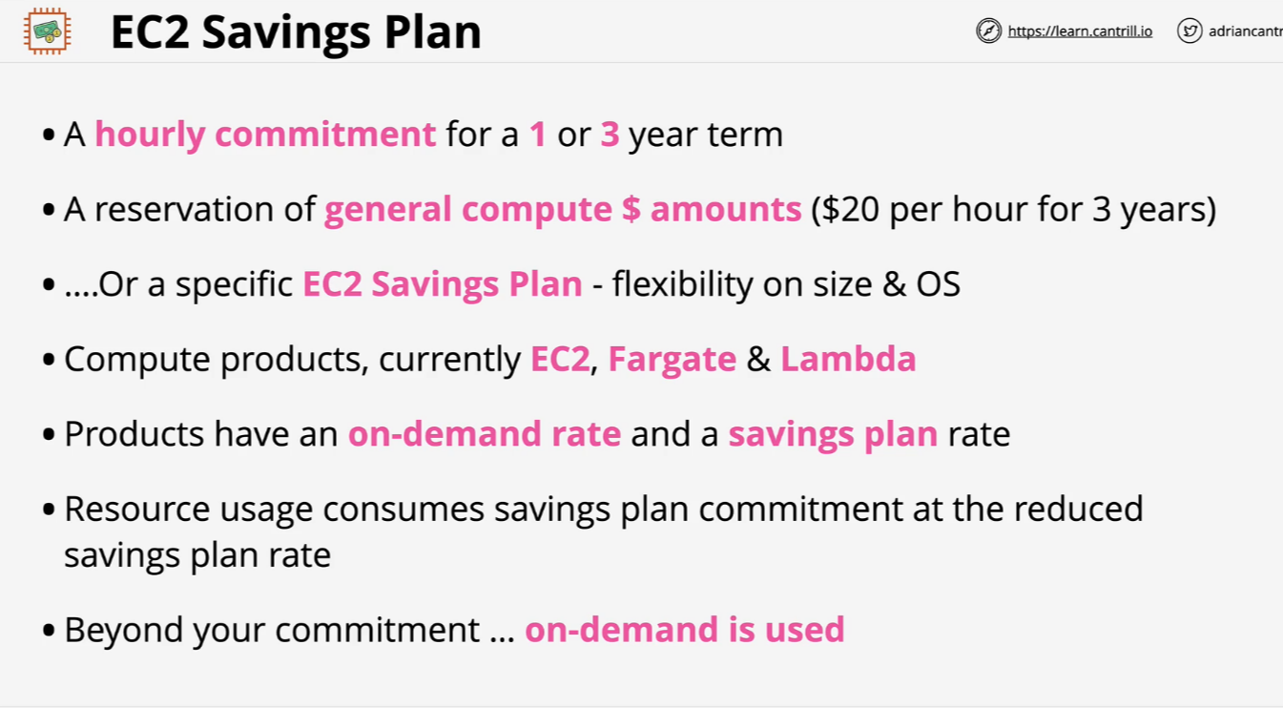
EC2 Saving Plan

Slide 35
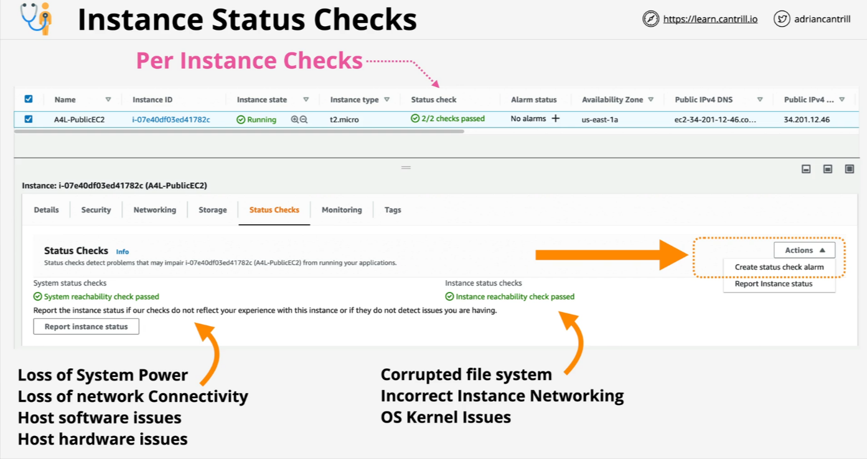
Instance Status Checks

Slide 36
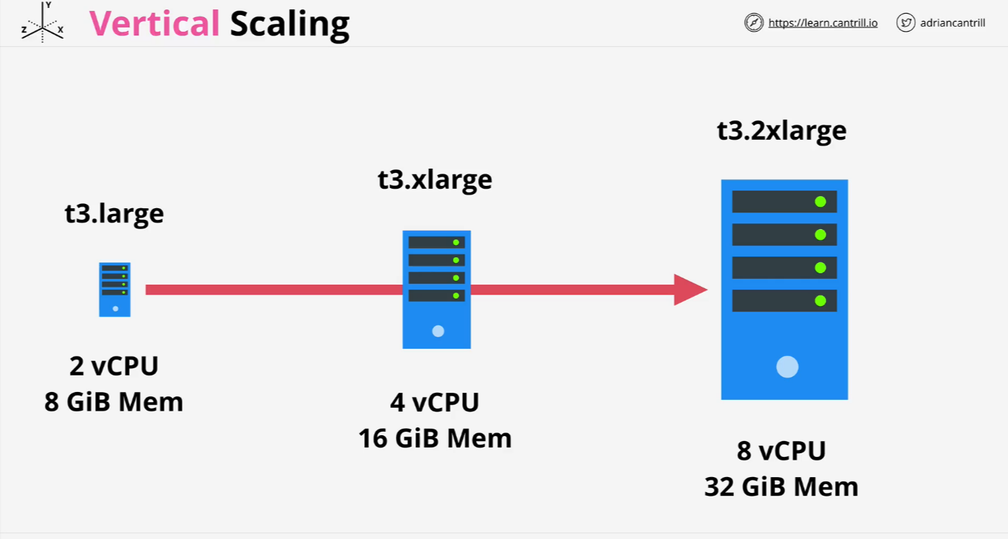
Vertical Scaling

Slide 37
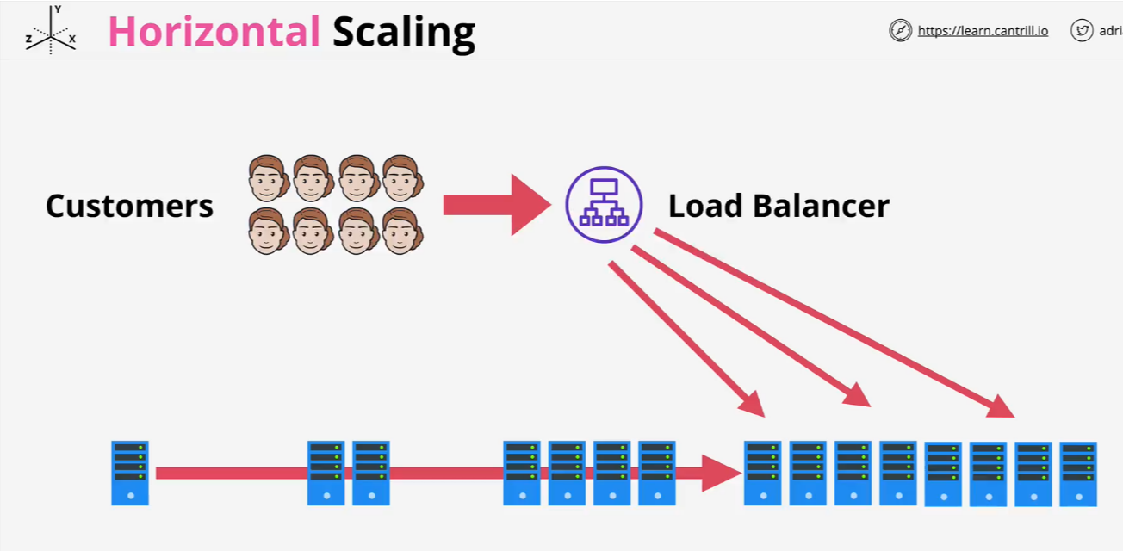
Horizontal Scaling

Slide 38
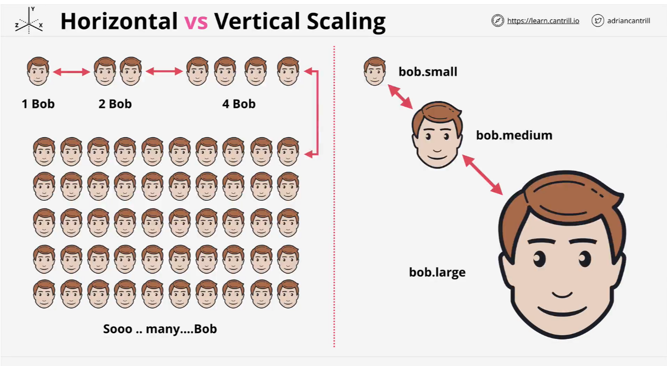
Vertical vs Horizontal Scaling

Slide 39
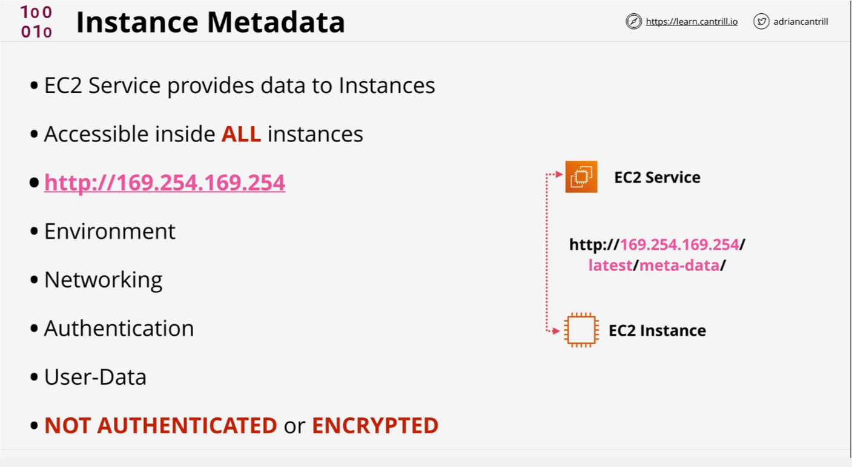
Instance Metadata

Slide 40
Instance Metadata
We use the commands given in the link below to see
meta-data.
https://learn-cantrill-labs.s3.amazonaws.com/awscoursedemos/0009-aws-associate-ec2-instance-metadata/lesson_commands.txt

